Slide 1
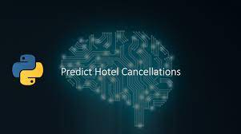

Hotel Booking Analysis & Prediction
Vikas Ranjan
DSC680, Summer 2021
Bellevue University, NE

Slide 2
Problem Statement
The hotel industry is subdivision of the hospitality industry. With a global average of almost 40% cancellation rate, this trend produces a very negative impact on hotel revenue and distribution management strategies.
This project is focused on building a model to predict predicting a cancellation on a hotel room booking.
Fetch and analyze key insights from the data set.
Such insights and predictions are going to help the hotel management utilize the staff and resources efficiently.

Slide 3
Process Overview
Preliminary analysis on data
Data preparation and cleaning for any missing values
Perform Exploratory Data Analysis
Train and test models
Model evaluation and tuning

Slide 4

Dataset Details
Dataset contains hotel booking information for a city hotel and a resort hotel.
This dataset includes 119391 rows and 32 feature variables.
Performed encoding on categorical variables based.
Performed normalization of numeric variables.

Slide 5
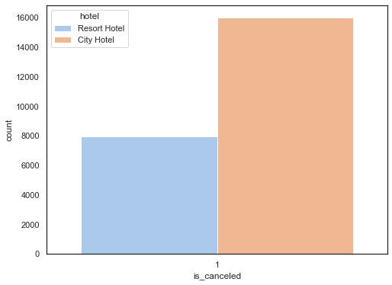
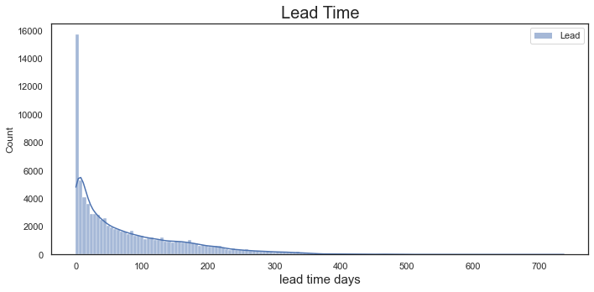
Graph Analysis

Slide 6
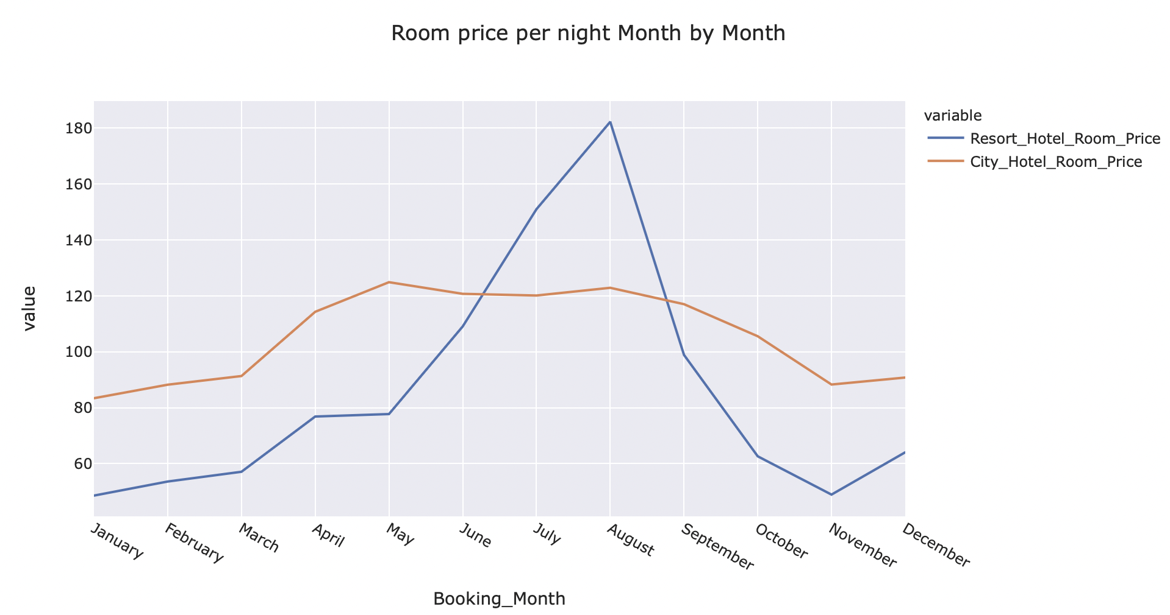
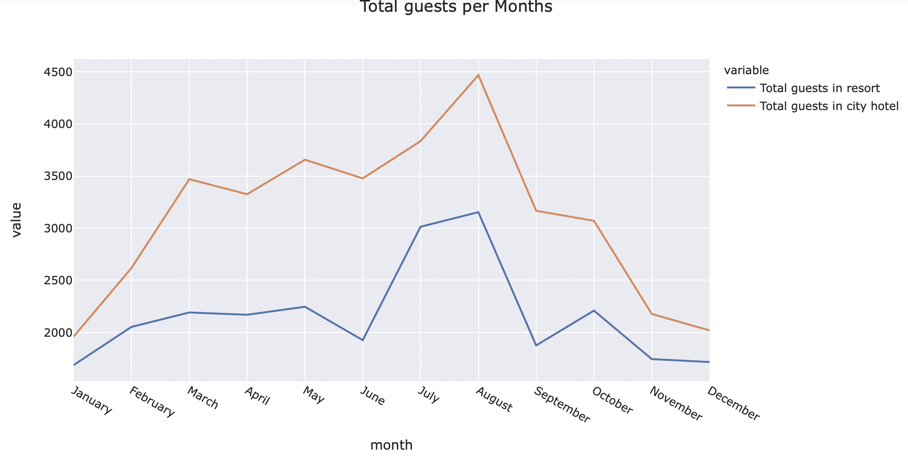
Graph Analysis

Slide 7
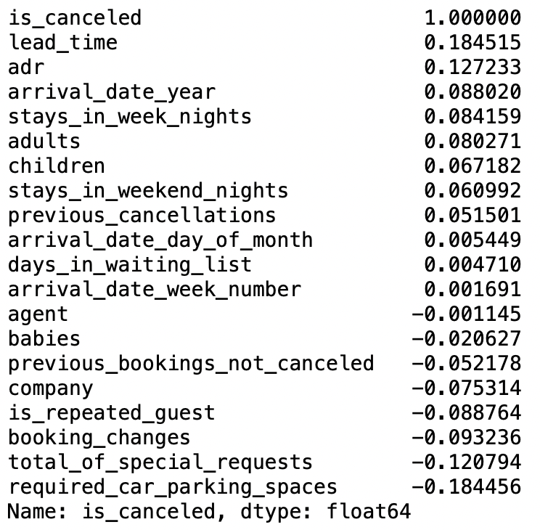
Correlations
The strongest positive correlations are with lead_time and adr.
The strongest negative correlations are with total_of_special_requests, required_car_parking_spaces and booking_changes.

Slide 8
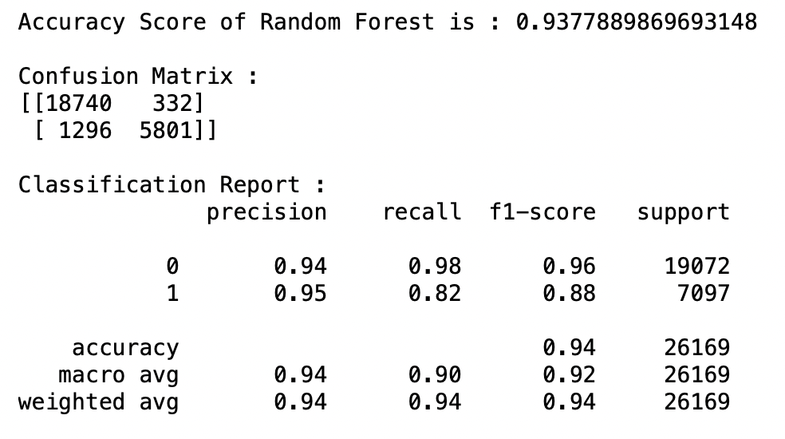
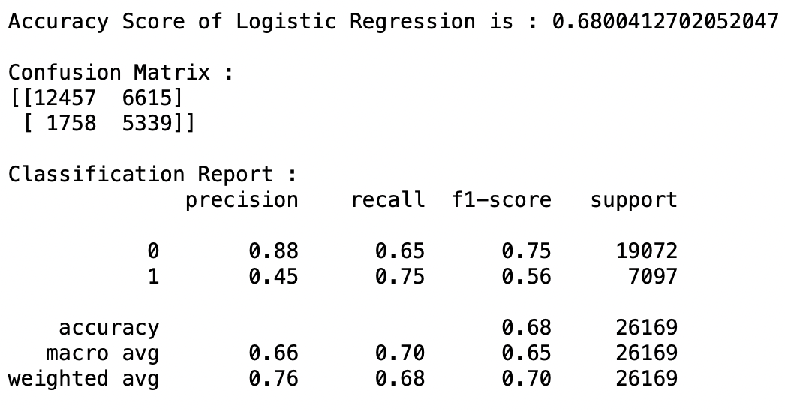
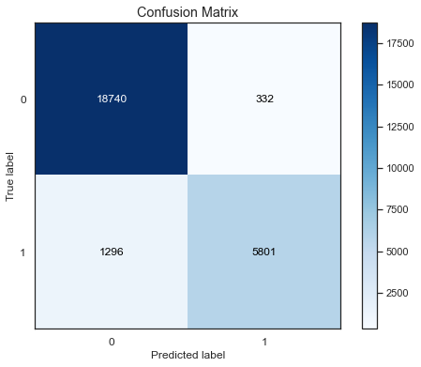
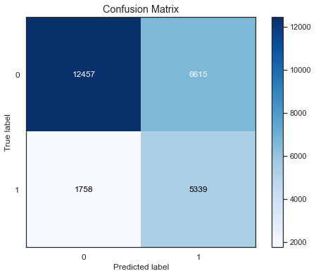
Models

Slide 9
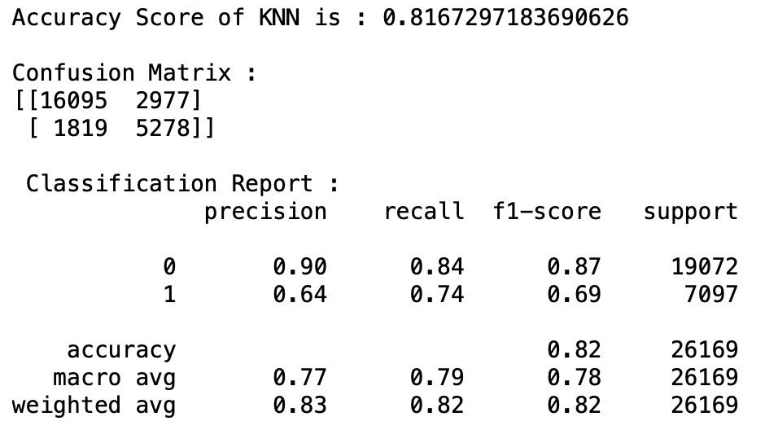
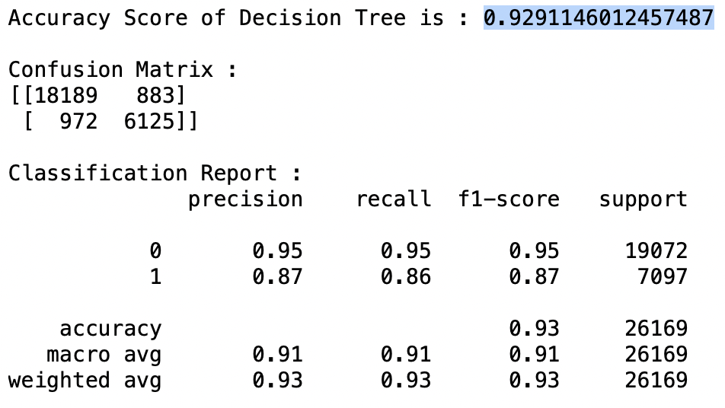
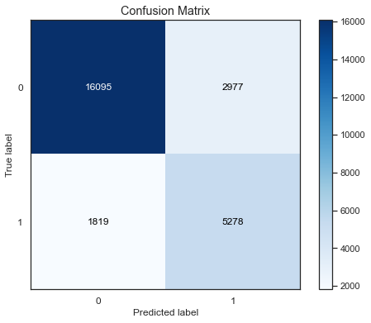
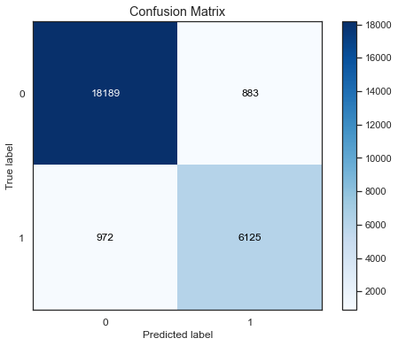
Models

Slide 10
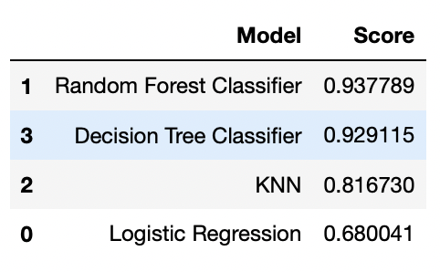
Models Evaluations
To predict if a booking will be cancelled, classification models are to be used.
Among the 4 classification models, Random Forest model had the best accuracy score, followed by Decision Tree classifier.

Slide 11
Conclusions
Random oversampling technique helped overcome the imbalanced datasets challenge.
Using Random Forest Model our model will correctly predict if a hotel room booking will be cancelled or not 93.78% of the time.
Decision Tree Model our model will correctly predict if a hotel room booking will be cancelled or not 92.91% of the time.
Random forest model has less false positives than Decision Tree making it a better model.

Slide 12
References
Mostipak, J. (2020, February 13). Hotel booking demand. Kaggle. https://www.kaggle.com/jessemostipak/hotel-booking-demand.
Predicting Hotel Bookings Cancellation with a Machine Learning Classification Model. IEEE Xplore. (n.d.). https://ieeexplore.ieee.org/abstract/document/8260781.
Adnan, D. (2020, August 26). Predicting a Hotel Booking Demand. Medium. https://towardsdatascience.com/predicting-a-hotel-booking-demand-7608a7dbf5a4.
Applied Text Analysis with Python, Benjamin Bengfort, Rebecca Bilbro & Tony Ojeda
Machine Learning with Python Cookbook, Chris Albon

